Slide 1
Introduction to Map Functions

Slide 2
Example: A function is defined, which squares a number if it's greater or equal to 0 and cubes it otherwise.
square_cube <- function(x){
if (x>=0){
y <- x^2
} else {
y<- x^3
}
return(y)
}
numbers<-c(1,-2,-3,4)
square_cube(numbers)
Output:

Slide 3
Here is a fix:
square_cube_loop <- function(x){
for(i in 1:length(x))
if (x[i]>= 0){
y[i] <- x[i]^2
} else {
y[i]<- x[i]^3
}
return(y)
}
y<-NA
square_cube_loop(numbers)
Output:

Slide 4
map(numbers, square_cube)
Output:
unlist(map(numbers, square_cube))
Output:

Slide 5
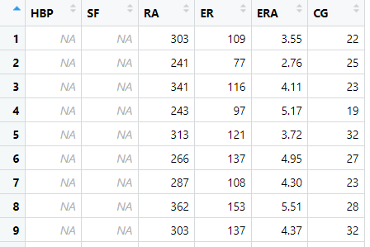
Data
illustration_data

Slide 6
map() Functions
What is the issue when I run this code?
median(illustration_data)

Slide 7
Map Functions: allow you to apply a function to each element of a list, vector, or dataframe. Map functions allow you to operate on entire vectors or data frames in a single step, without using explicit loops.

Slide 8
map(illustration_data, median)
unlist(map(illustration_data, median))
Output:

Slide 9
example_1 <- map_dbl(illustration_data, median)
example_1
Output:
example_2 <- map_chr(illustration_data, median)
example_2
Output:

Slide 10
example_3 <- map_dfr(illustration_data, median)
example_3
Output:

Slide 11
Map Functions when you have to use arguments
map_dbl(illustration_data, median, na.rm = TRUE)
Output:
Another notation:
map_dbl(illustration_data, \(x) median(x, na.rm = TRUE))
Output:

Slide 12
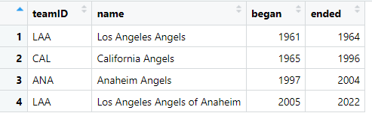
More Examples - Map Function - Iterating Over a Single Vector
illustration_data_2

Slide 13
Example: We want to find out the number of characters in the team name.
map_dbl(illustration_data_2, str_length)
Output:
map_dbl(illustration_data_2$name, str_length)
Output:
map_dfr(illustration_data_2, str_length)
Output:

Slide 14
More Examples - Map Function - Iterating Over Our Own Function
top5 <- function(team_name, data) {
output <- data %>%
filter(name == team_name) %>%
select(teamID, yearID, W, L, name) %>%
arrange(desc(W)) %>%
head(n = 5)
return(output)
}

Slide 15
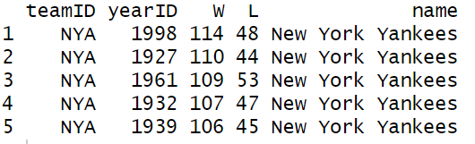
top5(team_name = "New York Yankees", data = Teams)
Output:

Slide 16
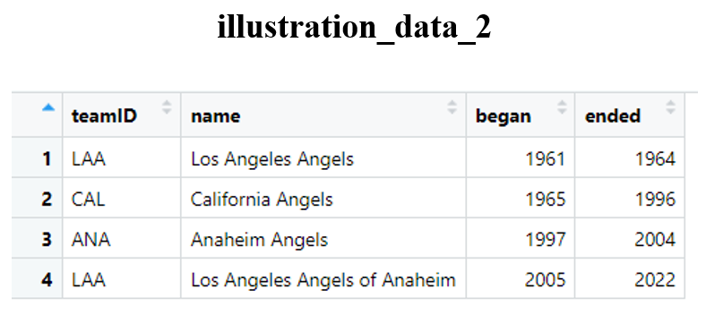
map_dfr(illustration_data_2$name, top5, Teams)

Slide 17
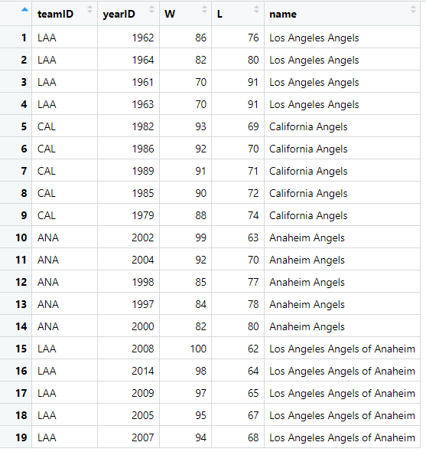
map_dfr(illustration_data_2$name, top5, Teams)
Output:

